Slide 1
Chain of responsibility Pattern
Amir Dirin Spring 2023

Slide 2
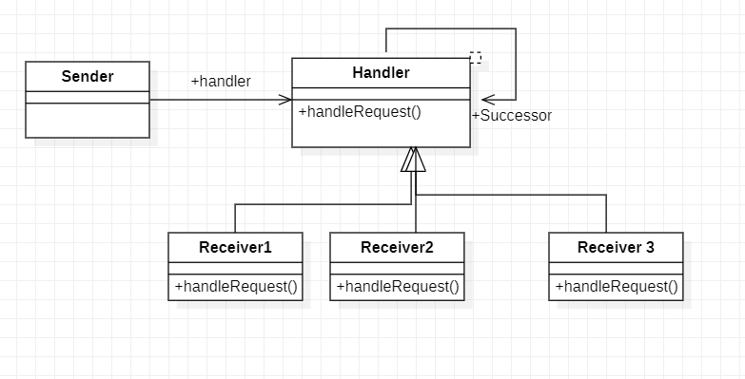
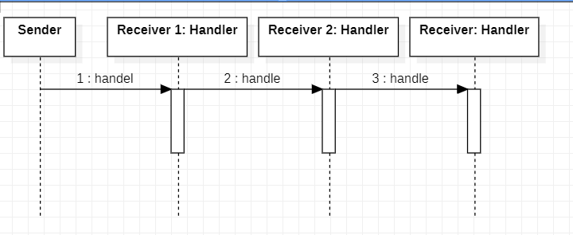
Chain of Responsibility
In chain of responsibility, sender sends a request to a chain of objects.
The request can be handled by an object in the chain.
If one object cannot handle the request then it passes the same to the next receiver and so on.
We send a request to a chain of receivers without having to know which one handle the request.

